Slide 1


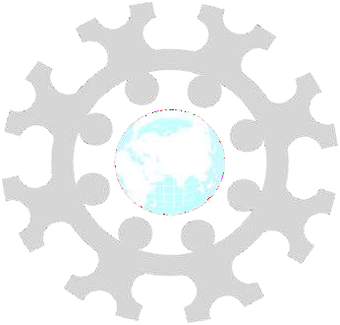
INSTITUTE: UIE (AIT-CSE)
CSS21: B.E. CSE (H) with specialization in Artificial Intelligence & Machine Learning
Advanced Machine Learning (20CSF-349)
Chapter 3.2.3 & 3.2.4: Clustering
Lecture 42: K-mode Clustering & DB scan Clustering
By: Mr. Siddharth Kumar
DISCOVER . LEARN . EMPOWER

Slide 2
Advanced Machine Learning
Course Outcome
CO | Title
1 | Have a good understanding of the fundamental issues and challenges of machine learning: data, model selection, model complexity, etc.
2 | Appreciate the underlying mathematical relationships within and across Machine Learning algorithms and the paradigms of supervised and un-supervised learning
3 | Design and implement various machine learning algorithms in a range of real-world applications.
4 | Design and evaluate intelligent expert models for perception and prediction using machine learning algorithms
5 | Analyze and make use of machine learning algorithms-based applications using performance

Slide 3
K-mode Clustering
Clustering is an unsupervised learning method whose task is to divide the population or data points into a number of groups, such that data points in a group are more similar to other data points in the same group and dissimilar to the data points in other groups. It is basically a collection of objects based on similarity and dissimilarity between them.
K-Modes clustering is one of the unsupervised Machine Learning algorithms that is used to cluster categorical variables.
You might be wondering, why K-Modes when we already have K-Means.
K-Means uses mathematical measures (distance) to cluster continuous data. The lesser the distance, the more similar our data points are. Centroids are updated by Means.
But for categorical data points, we cannot calculate the distance. So we go for K-Modes algorithm. It uses the dissimilarities(total mismatches) between the data points. The lesser the dissimilarities the more similar our data points are. It uses Modes instead of means.

Slide 4
How does the K-Modes algorithm work?
Unlike Hierarchical clustering methods, we need to upfront specify the K.
Pick K observations at random and use them as leaders/clusters
Calculate the dissimilarities and assign each observation to its closest cluster
Define new modes for the clusters
Repeat 2–3 steps until there are is no re-assignment required
I hope you got the basic idea of the K-Modes algorithm by now. So let us quickly take an example to illustrate the working step by step.

Slide 5
Density-based clustering
Density-based clustering refers to a method that is based on local cluster criterion, such as density connected points. In this tutorial, we will discuss density-based clustering with examples.
What is Density-based clustering?
Density-Based Clustering refers to one of the most popular unsupervised learning methodologies used in model building and machine learning algorithms. The data points in the region separated by two clusters of low point density are considered as noise. The surroundings with a radius ε of a given object are known as the ε neighborhood of the object. If the ε neighborhood of the object comprises at least a minimum number, MinPts of objects, then it is called a core object.
Working of Density-Based Clustering
Suppose a set of objects is denoted by D', we can say that an object I is directly density reachable form the object j only if it is located within the ε neighborhood of j, and j is a core object.

Slide 6
An object i is density reachable form the object j with respect to ε and MinPts in a given set of objects, D' only if there is a sequence of object chains point i1,…., in, i1 = j, pn = i such that ii + 1 is directly density reachable from ii with respect to ε and MinPts.
An object i is density connected object j with respect to ε and MinPts in a given set of objects, D' only if there is an object o belongs to D such that both point i and j are density reachable from o with respect to ε and MinPts.
Major Features of Density-Based Clustering
The primary features of Density-based clustering are given below.
It is a scan method.
It requires density parameters as a termination condition.
It is used to manage noise in data clusters.
Density-based clustering is used to identify clusters of arbitrary size.

Slide 7
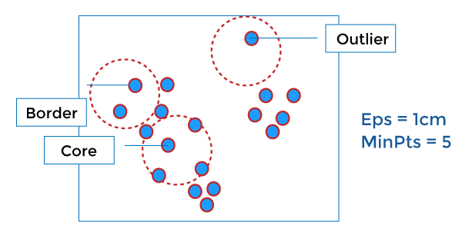
Density-Based Clustering Methods
DBSCAN: It stands for Density-Based Spatial Clustering of Applications with Noise. It depends on a density-based notion of cluster. It also identifies clusters of arbitrary size in the spatial database with outliers.

Slide 8
OPTICS: It stands for Ordering Points To Identify the Clustering Structure. It gives a significant order of database with respect to its density-based clustering structure. The order of the cluster comprises information equivalent to the density-based clustering related to a long range of parameter settings. OPTICS methods are beneficial for both automatic and interactive cluster analysis, including determining an intrinsic clustering structure.
DENCLUE: Density-based clustering by Hinnebirg and Kiem. It enables a compact mathematical description of arbitrarily shaped clusters in high dimension state of data, and it is good for data sets with a huge amount of noise.

Slide 9
References
T1: Mitchell T.M., Machine Learning, McGraw Hill (1997).
T2: Andreas C. Miller, Sarah Guido, Introduction to Machine Learning with Python, O’REILLY (2001).
Notes:
Introduction to Cyber Security (simplilearn.com)

Slide 10

THANK YOU

